Slide 1
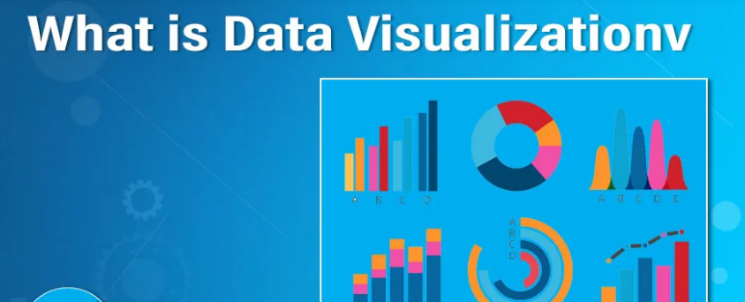
Data Visualization
The representation of data or information in graphical
the viewer can easily understand the process of trends in the data is called data visualization.

Slide 2
Data Visualization
Any visual elements are used so that the trends, outliers, and patterns can be understood and studied from the data.
Different tools used for data visualization include charts, maps, and graphs, and so on.

Slide 3

Importance of data visualization
data cleaning
detecting outliers and unusual groups
identifying trends and clusters
presenting results.
It is essential for exploratory data analysis and data mining to check data quality.

Slide 4

Notes to Visualize Your Data
Colors
• choosing color according to the environment and suitable to your data.
Orange : means productivity.
Red: danger
Blue : trust(revenue)
Green : acceptance or balance.

Slide 5
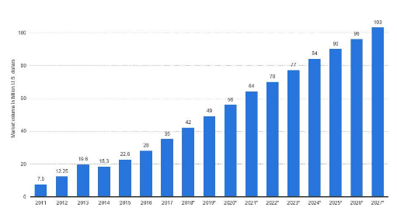
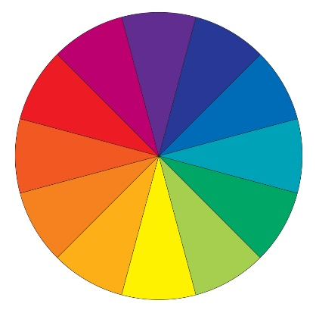
Notes to Visualize Your Data
Simplicity

Slide 6
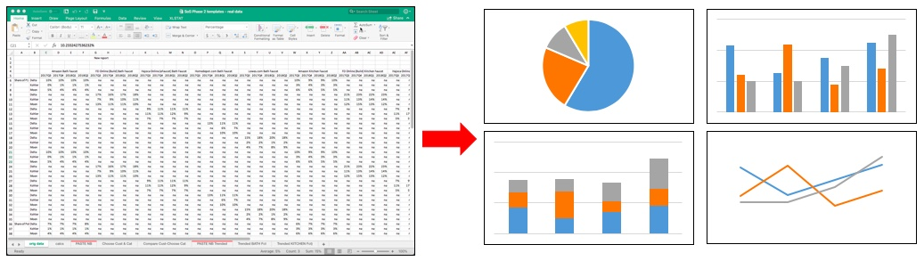
Notes to Visualize Your Data
the picture is summarize 1000 words

Slide 7
Plots

Slide 8
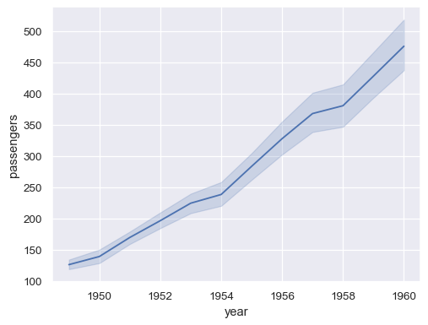
Line Plot

Slide 9
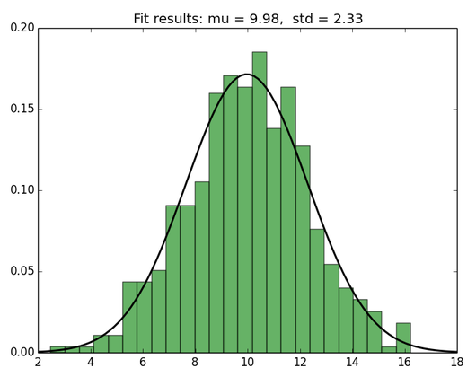
Histogram

Slide 10
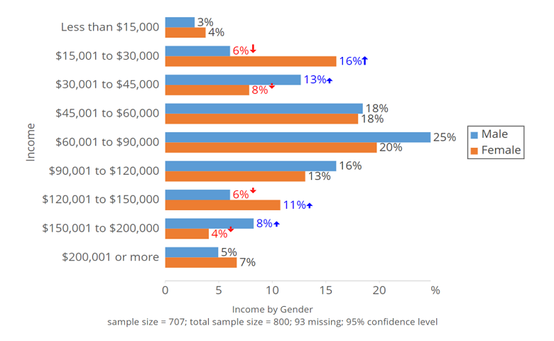
Bar Chart

Slide 11
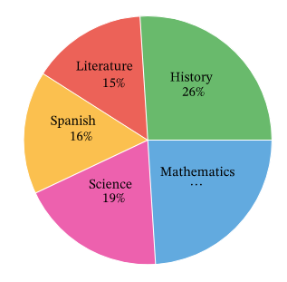
Pie Chart

Slide 12
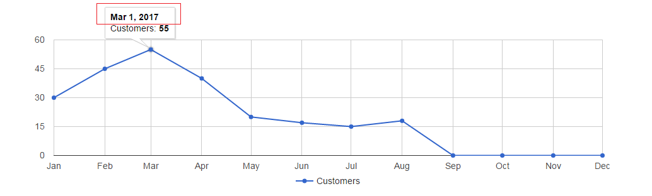
Date

Slide 13
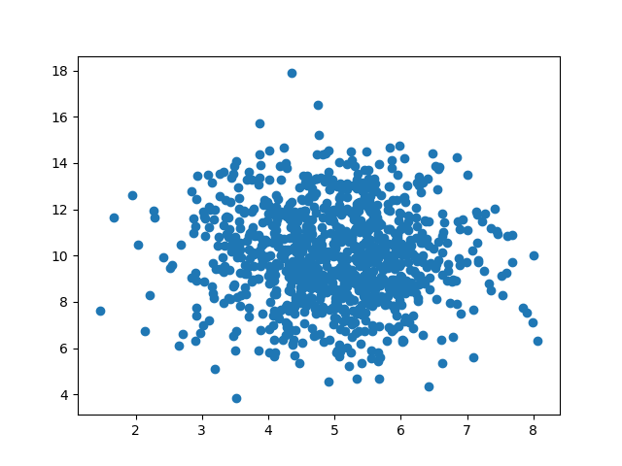
Scatter Plot

Slide 14
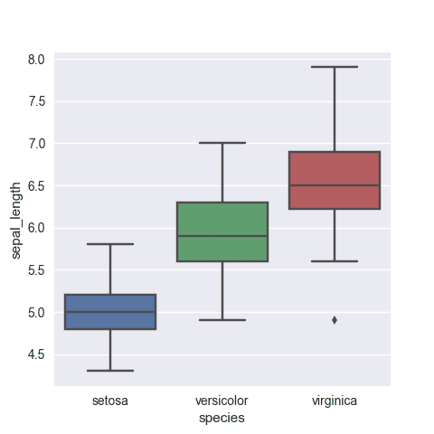
Box Plot

Slide 15

Data Visualization Tools
Seaborn
Matplotlib
Pandas visualization
Plot.ly
Tableau
Power BI

Slide 16
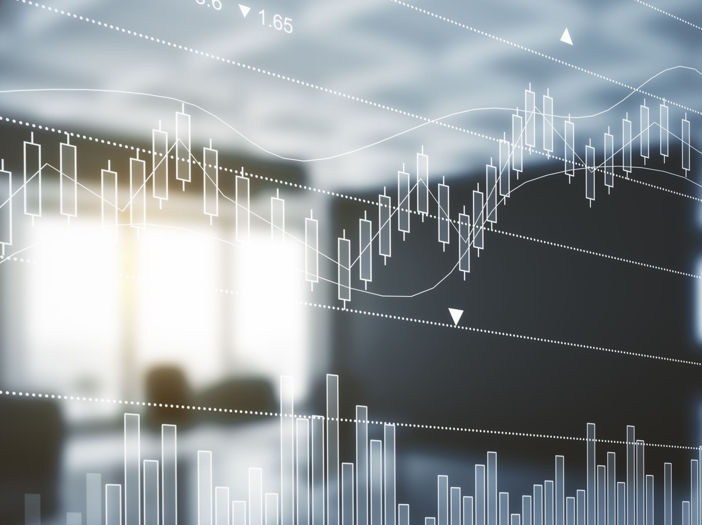
Data Set

